Slide 1
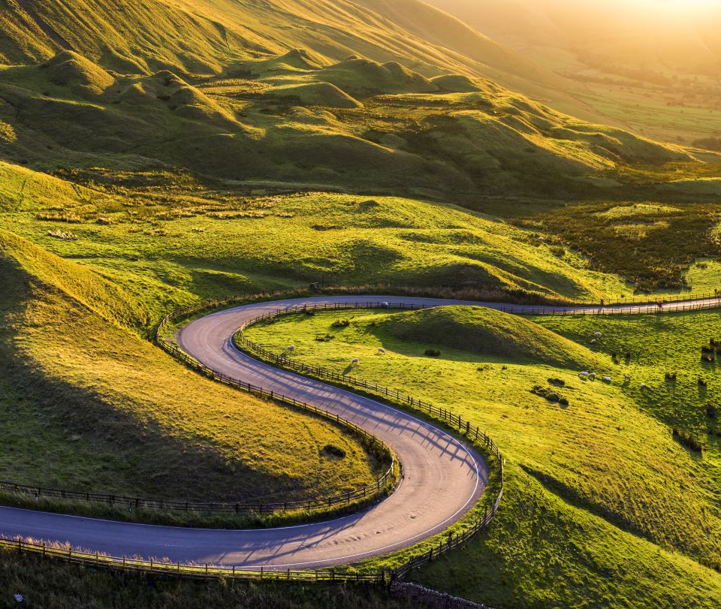
Final project – betting horses
Andrea pappa
Jake geiser
Carlie azar
Erin lee
Dave moorman

Slide 2
agenda
View into the Website
Solution Approach
Machine Learning Model
Observed Outcomes
Other Conditions to Consider for Selecting Your Winning Horse
Betting Strategies
Head Over to the Website!

Slide 3
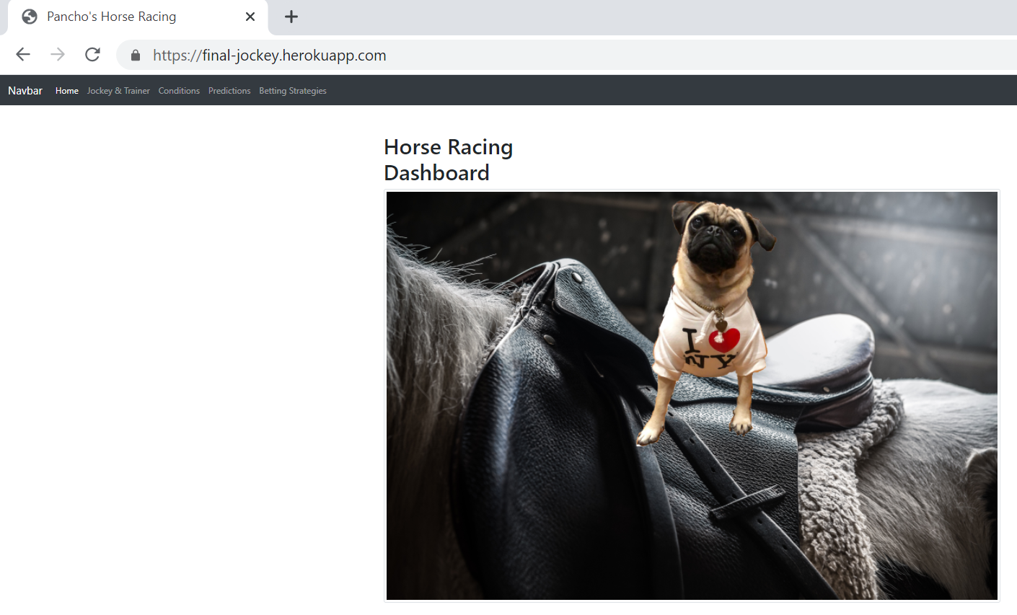
Welcome to pancho’s horse racing
https://final-jockey.herokuapp.com/

Slide 4
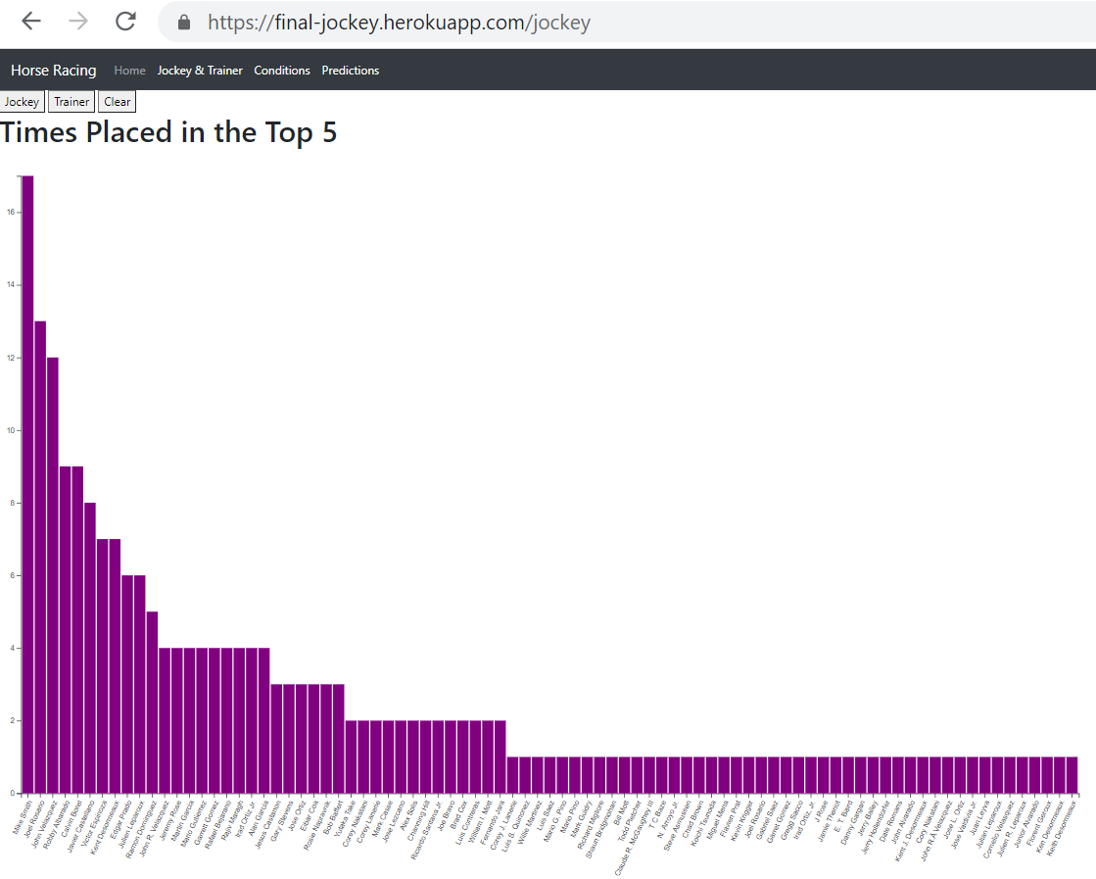
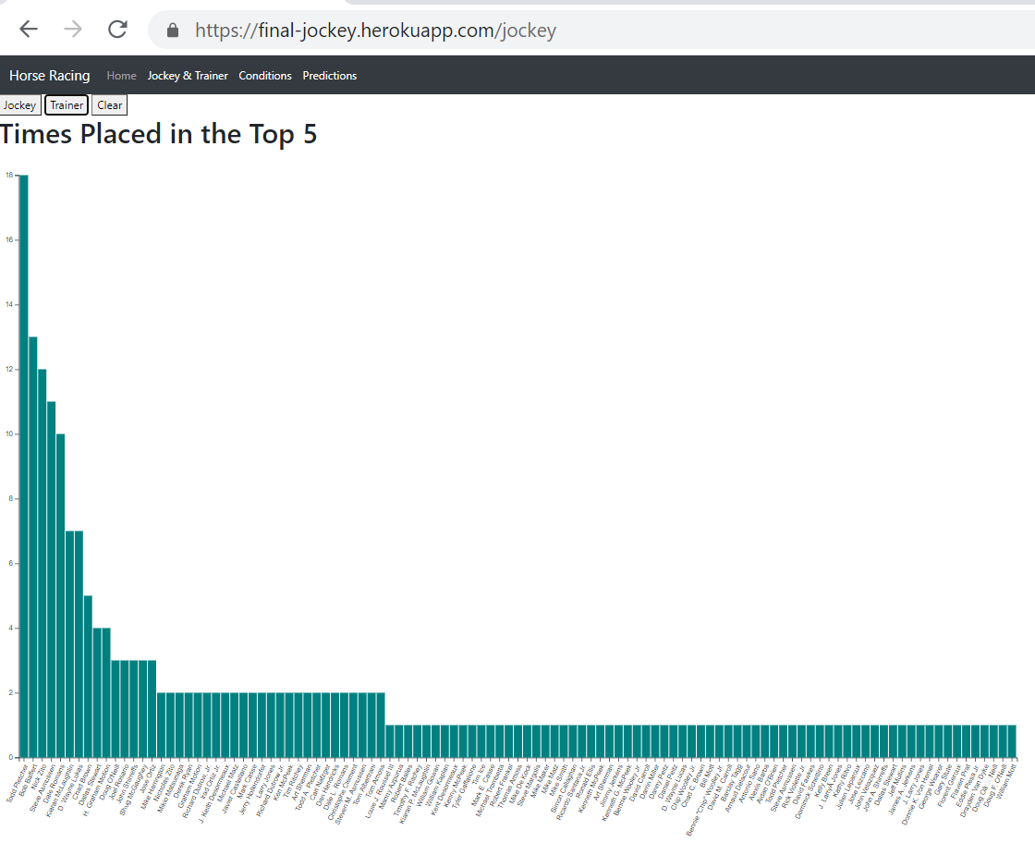
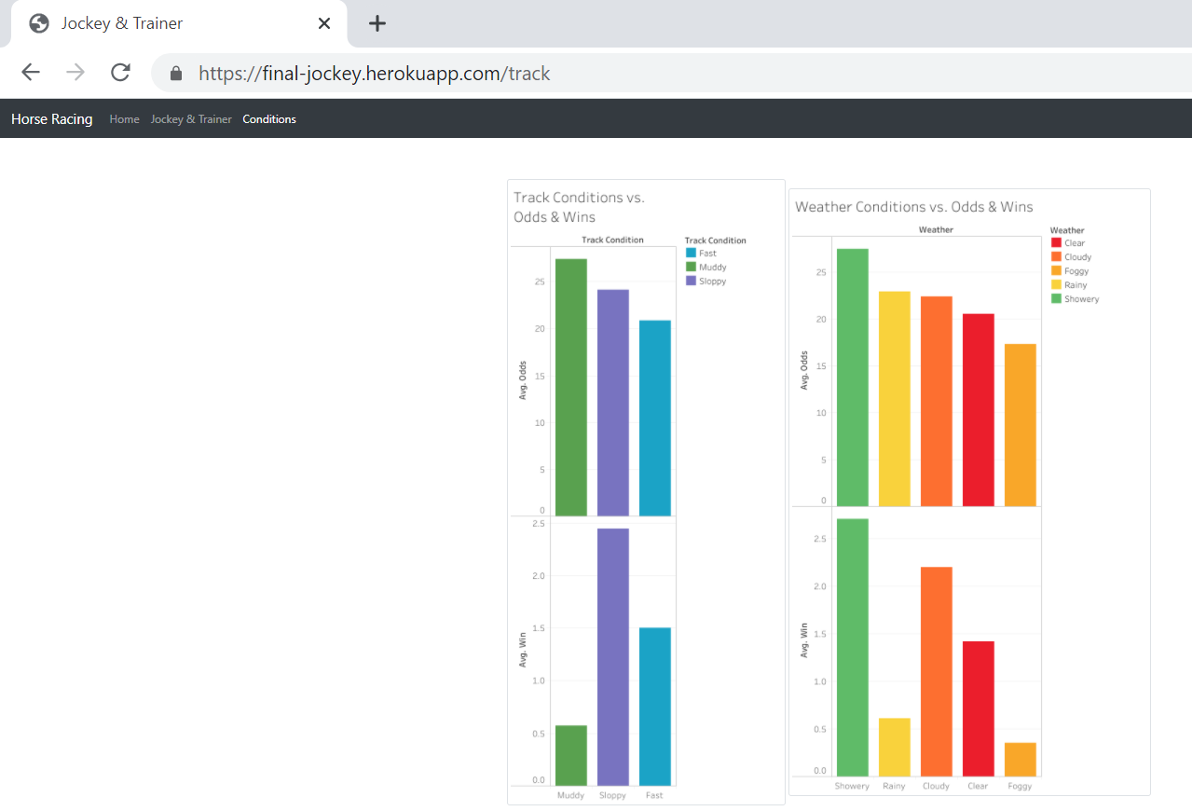
Jockey and trainer track and weather conditions

Slide 5
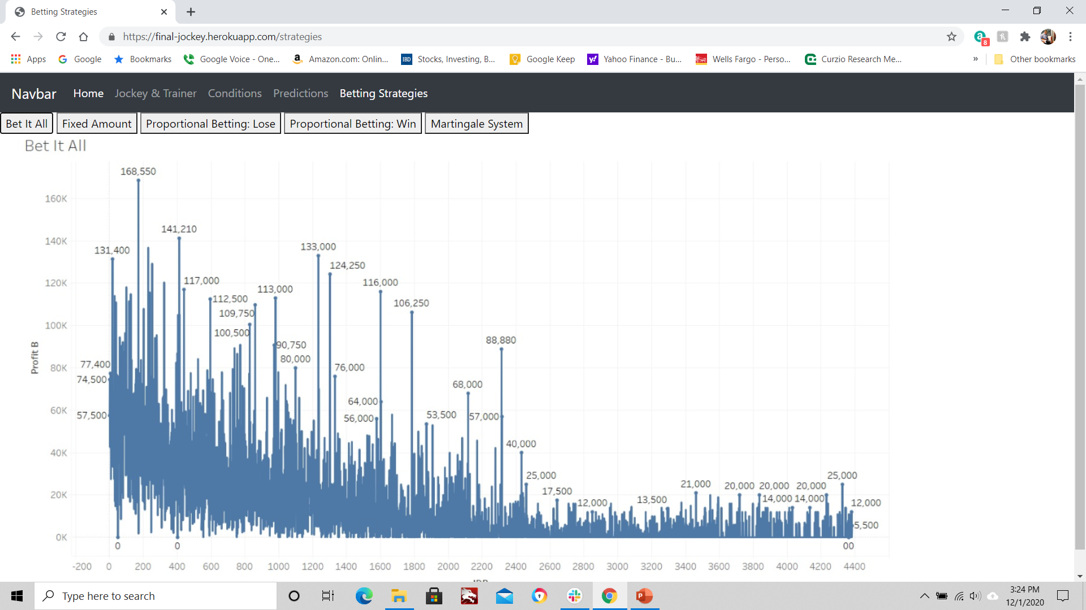
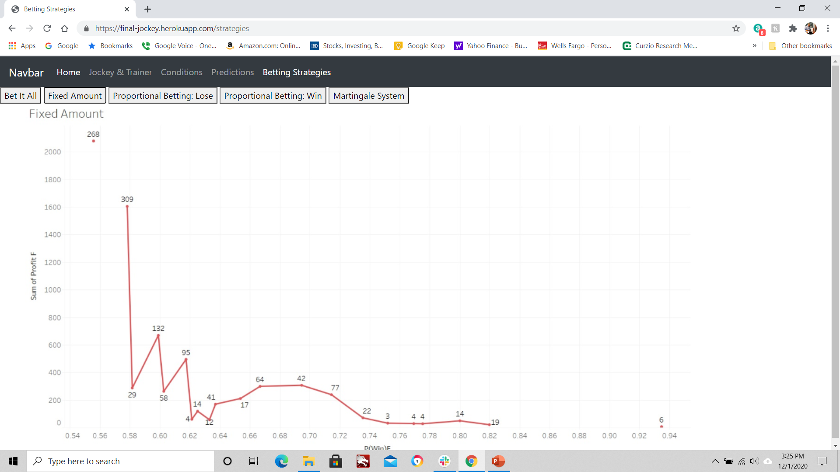
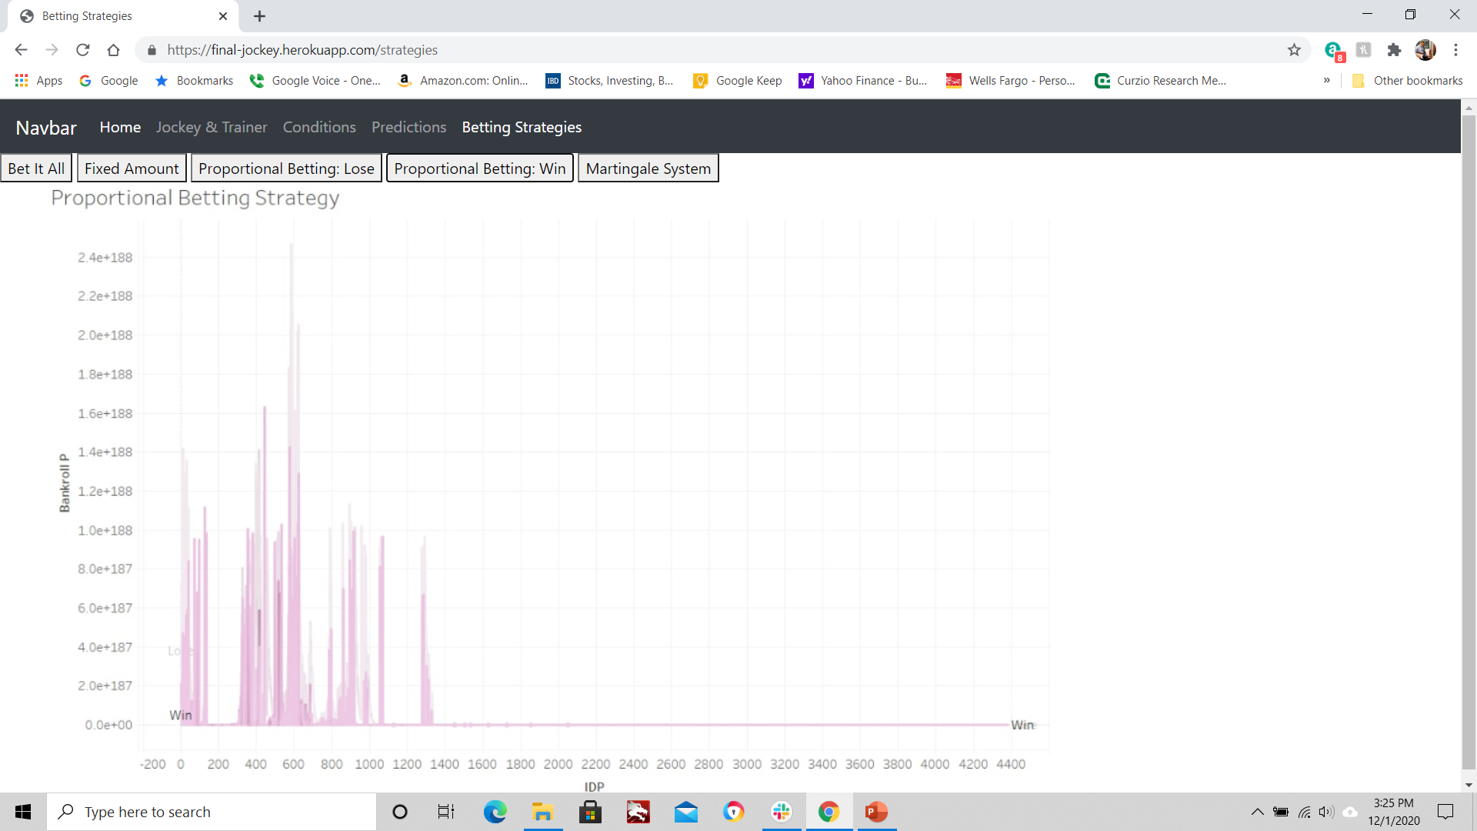
Betting strategy analysis

Slide 6
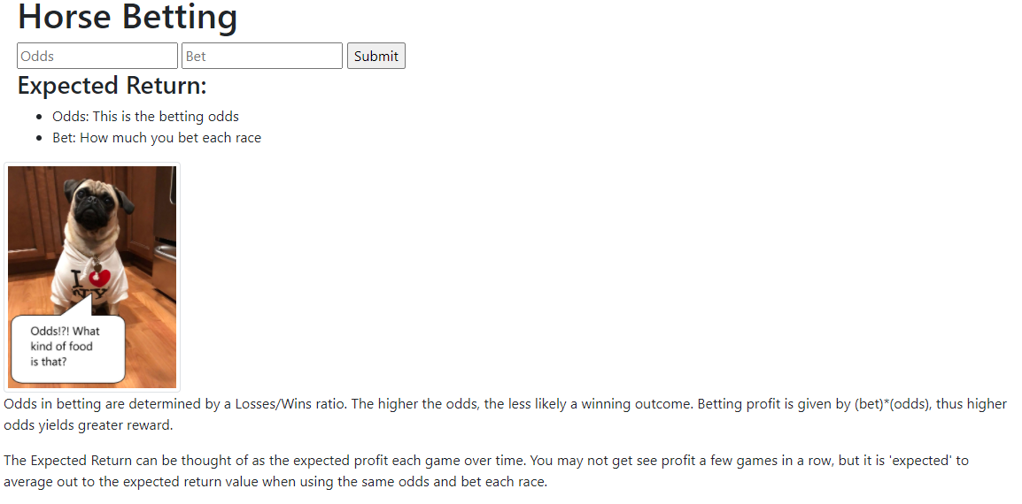
Estimate profit using backend machine model

Slide 7
approach
JavaScript with Flask
Visualizations
D3
JavaScript Plotly
Tableau
Machine Learning using Linear SVM Model (Pandas)
Scikit-Learn
Excel Pivot Tables
Hosting Website on Heroku

Slide 8
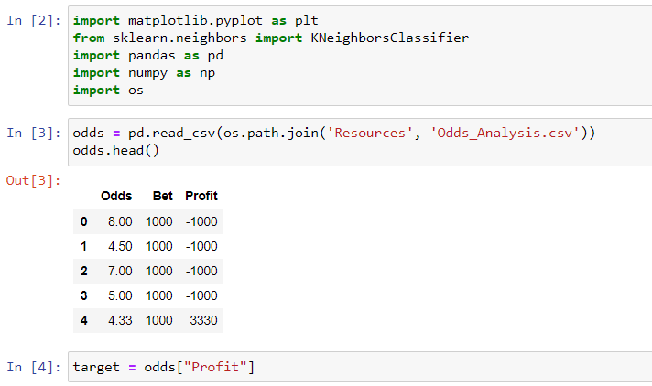

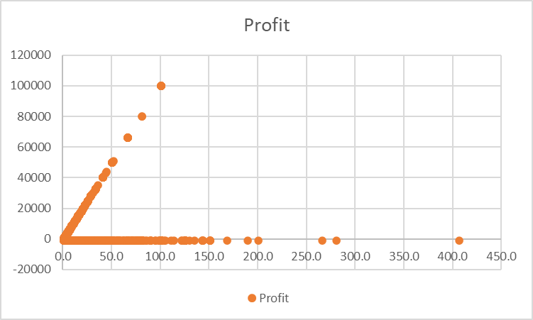

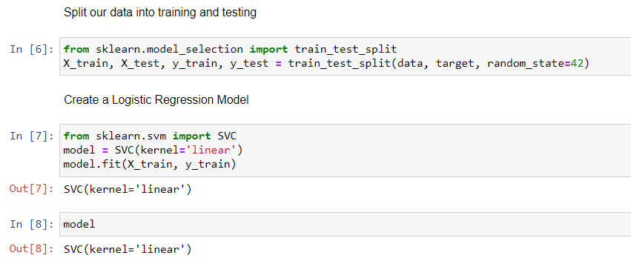
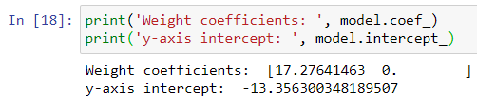
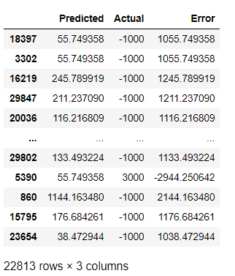
Machine learning model
Profit = -13.356 + 17.28 * odds
Regression Analysis and Testing

Slide 9
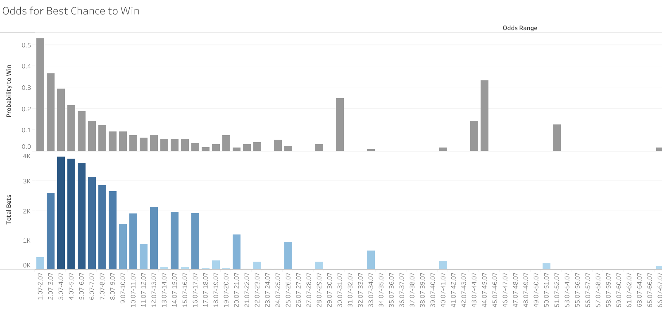
Higher chance of winning with the best odds
Data shows a 53% chance of winning with odds in the 1 to 2 range.
Gamblers won 36% of the time when betting on odds within 2 to 3.
As expected, the observed probability of winning drops down significantly as the betting odds get higher.
ODDS RANGE
https://public.tableau.com/profile/david.moorman#!/vizhome/HorseRacingOddsBetting/OddsforBestChancetoWin?publish=yes

Slide 10
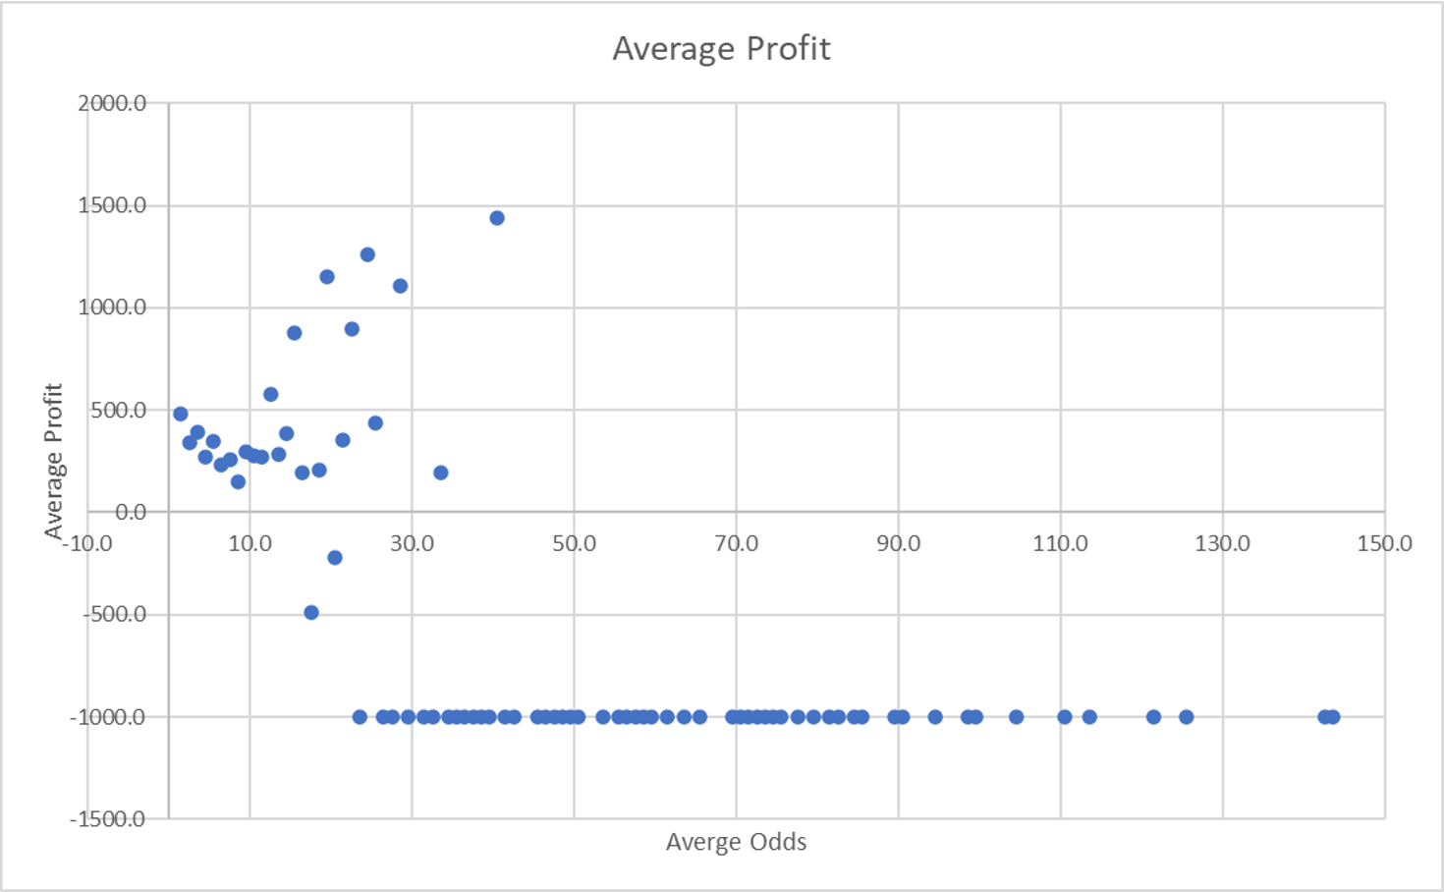
Average profit expectation per odds
Better the odds will typically provide a higher probability of profit.
Higher profit on average for lower odds, but lower probability of winning

Slide 11
Other conditions to consider for selecting your winning horse

Slide 12
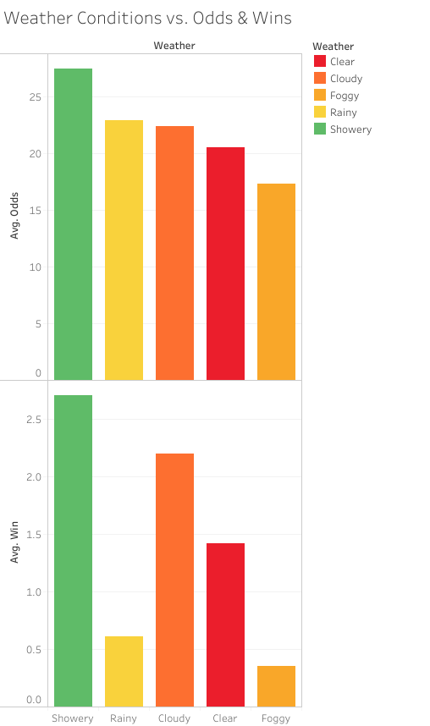
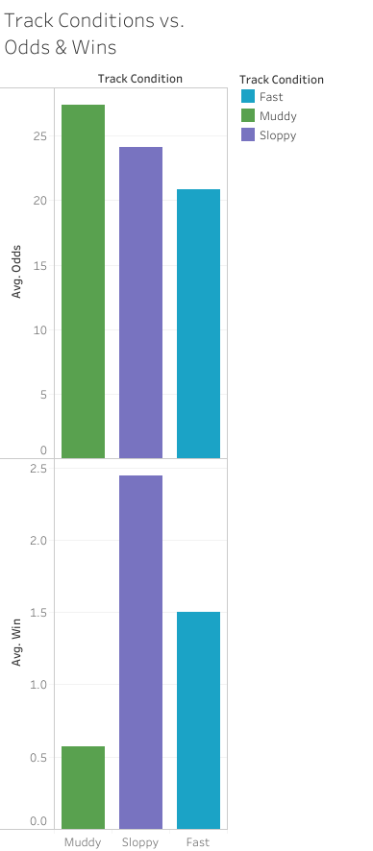
weather and track conditions can help underdogs
Underdogs love showery weather and muddy tracks

Slide 13
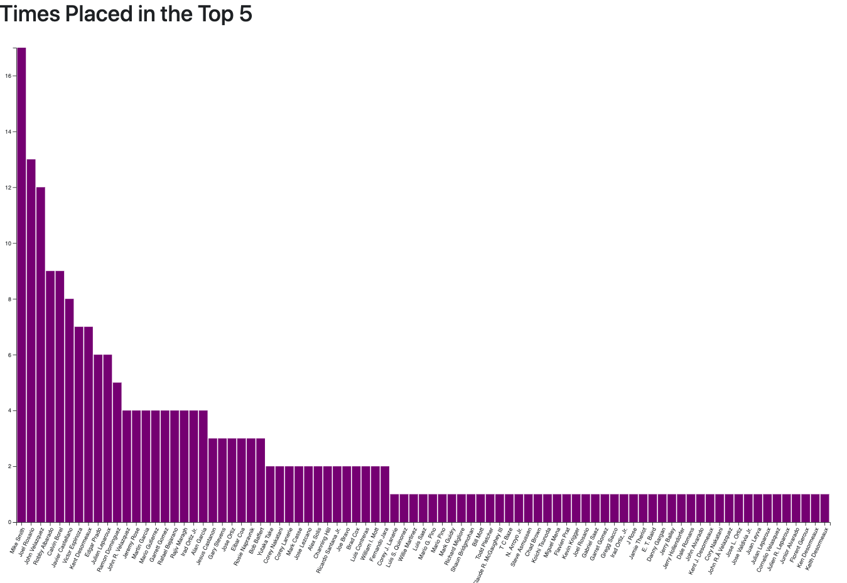
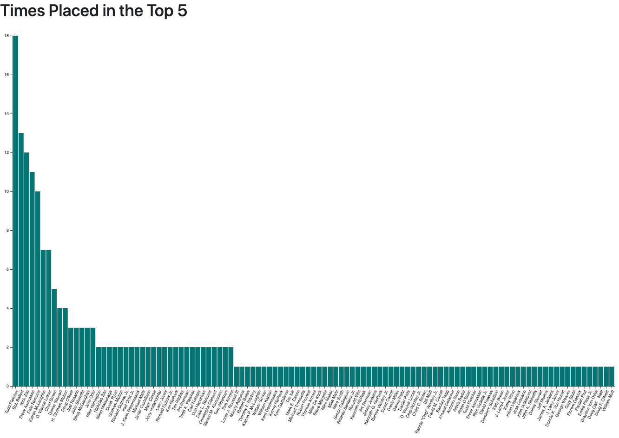
Winning horses typically have a winning team
Wins by Jockey
Wins by Trainer

Slide 14
Betting strategies

Slide 15
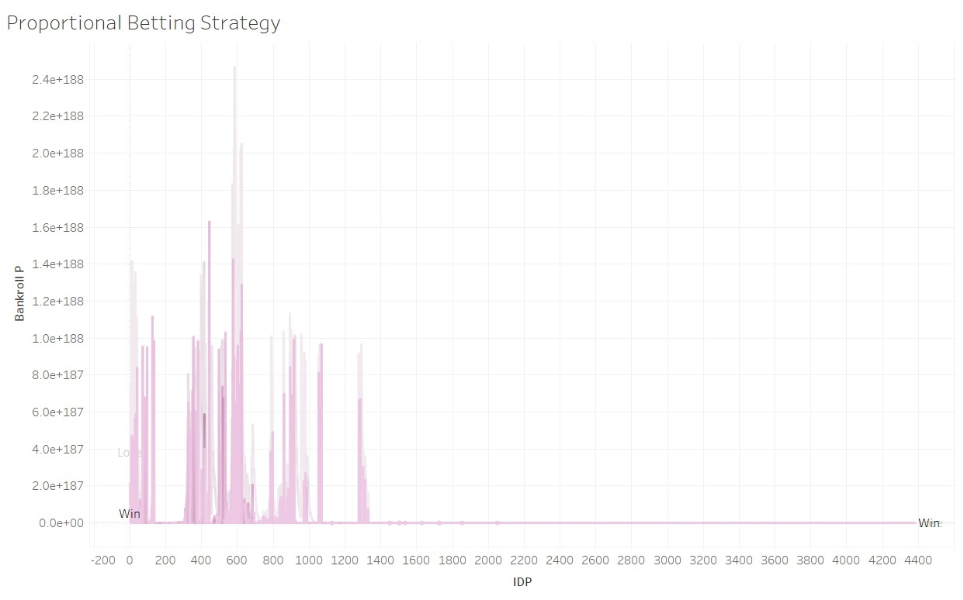
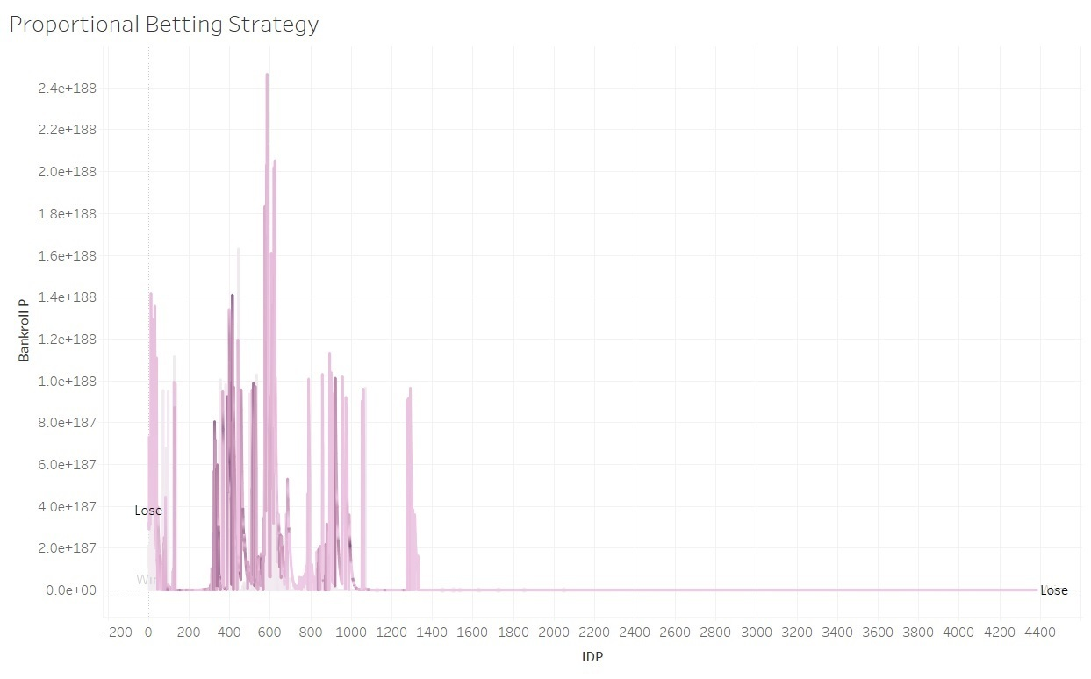
Proportional betting
Proportional Betting - Win
Proportional Betting - Lose

Slide 16
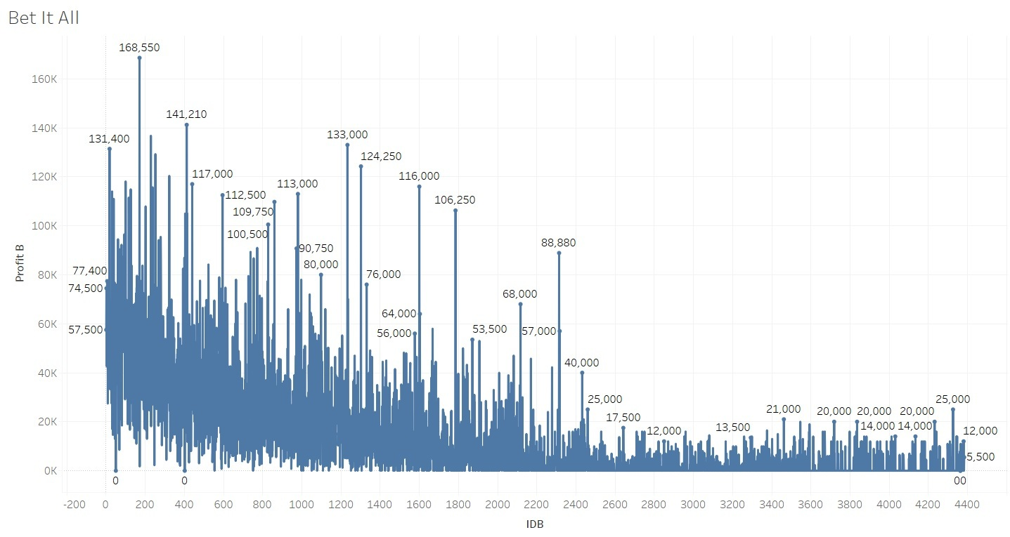
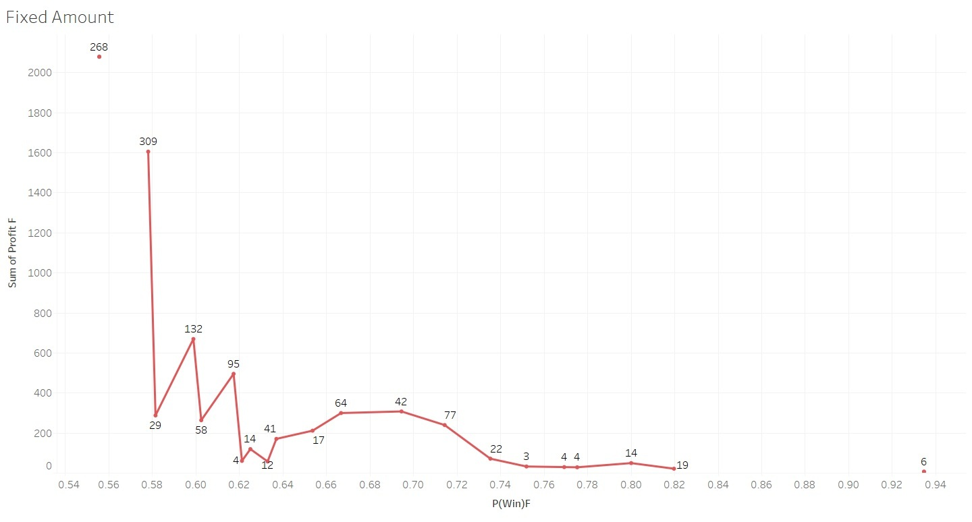
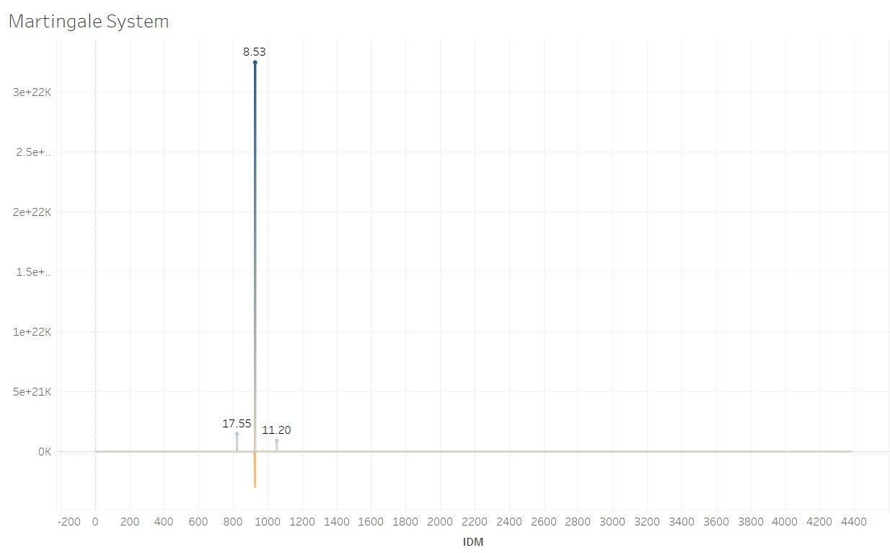
Other strategies
Bet It All
Fixed Amount
Martingale System

Slide 17
Head over to the website!

